Slide 1
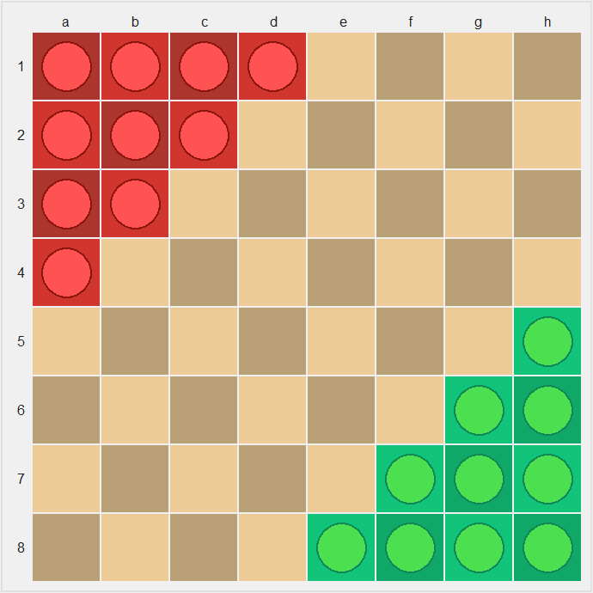
Halma
CS181 Final Project
熊章智，杨天倪，冯令康

Slide 2
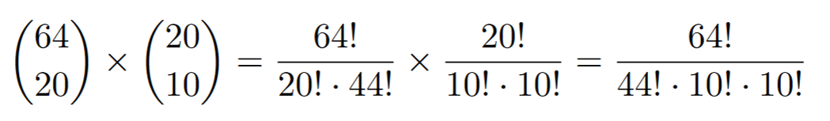
Setting
8*8 grids
20 pawns in total (10 per side)
Around 10²⁸ States!

Slide 3
Implement methods
Human Player
Random
Greedy
Minimax (alpha-beta pruning; local search technique)
MCTS
(Conventional) Approximate Q-learning
Neural Approximate Q-learning (NAQL, a.k.a, DQN)
Misc: Change the Rule and Explore!

Slide 4
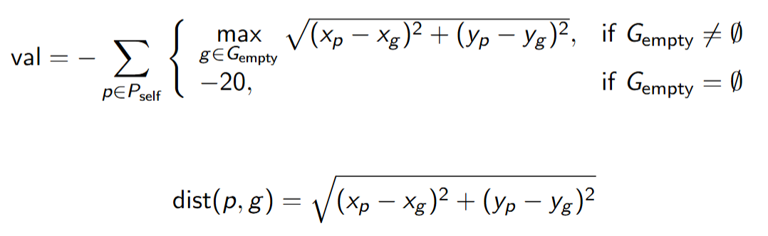
State Evaluation
Calculate the Euclidean distance from the pawn to every empty or non-player-occupied position in the player's goal area.
If there are available goal positions, add the maximum of these distances to a running total (val).
If there are no available goal positions for that pawn, subtract 20 from the total as a penalty.
After evaluating all pawns: Multiply the total score by -1, so that a smaller distance (i.e., pawns closer to the goal) results in a higher evaluation score.

Slide 5
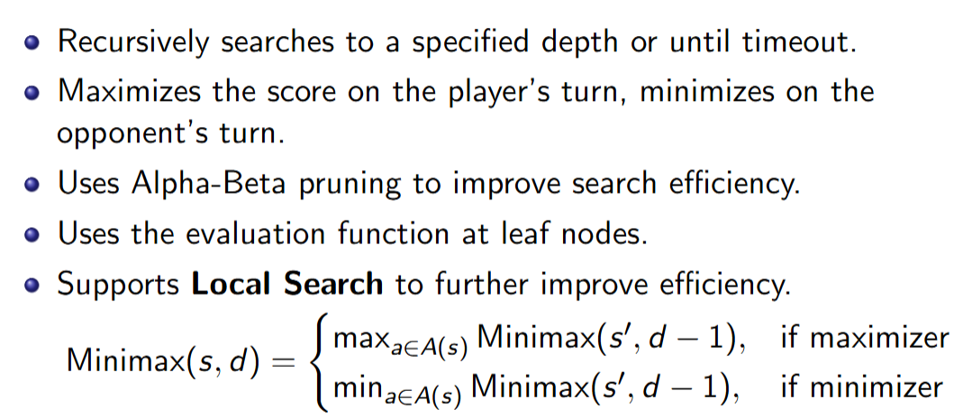
Basic Methods
Random & Greedy
Minimax with alpha-beta pruning:

Slide 6
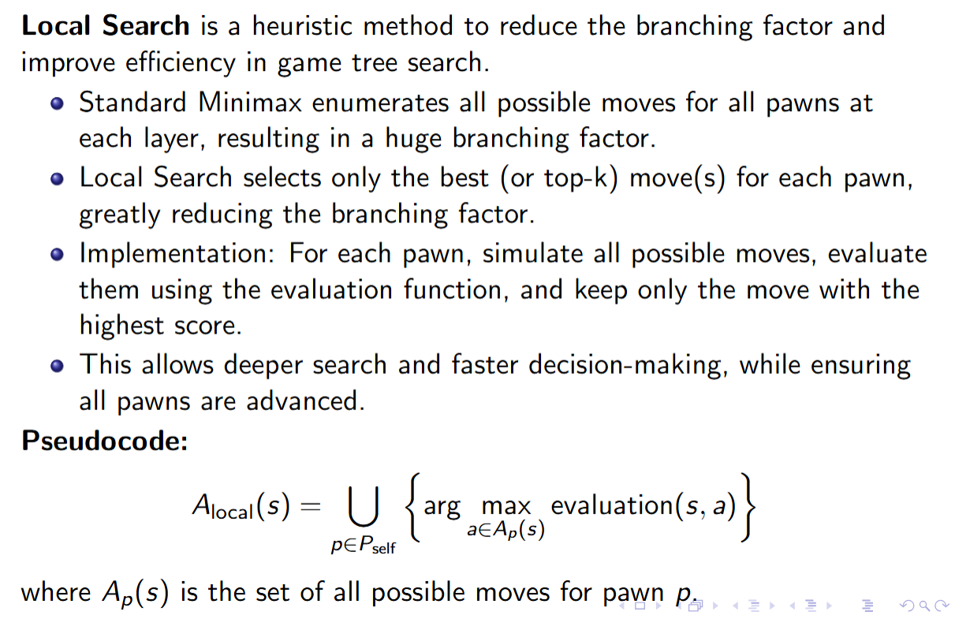
Minimax with Local Search Technique

Slide 7
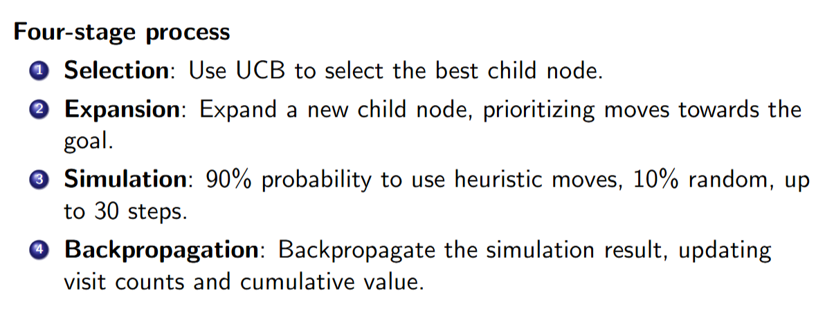
MCTS

Slide 8
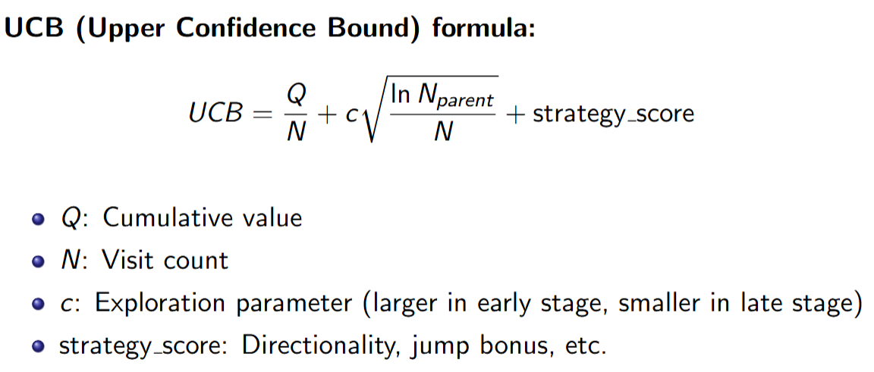
MCTS

Slide 9
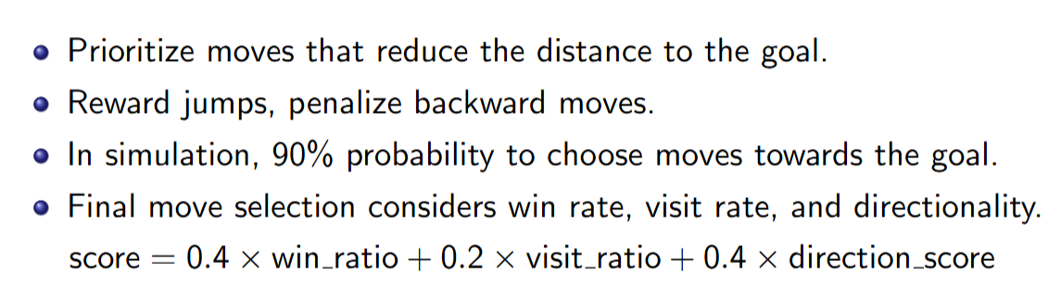
MCTS

Slide 10
Q-learning
Unfortunately, we failed to train a Q-learning agent...
First of all, (s, a) pairs are numerous. The file containing trained parameters after 200 episodes is 21GB!
Secondly, it is hard to train. We tried letting Q-learning to fight against random/minimax/Q-learning agents, but failed.

Slide 11
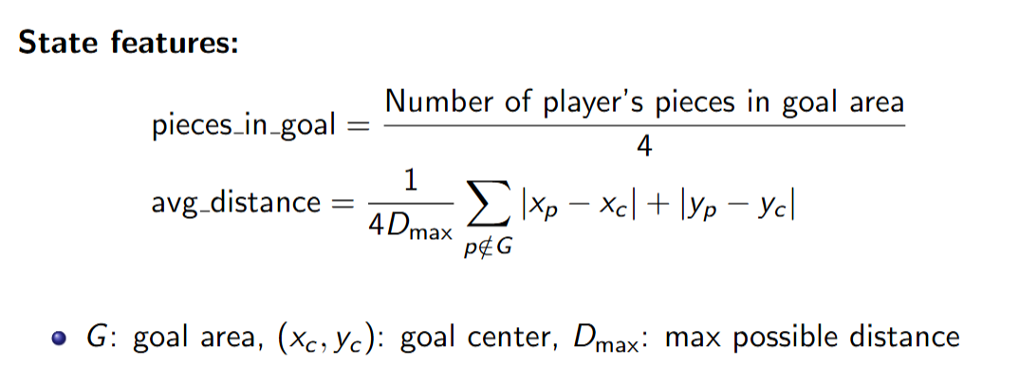
Approximate Q-learning

Slide 12
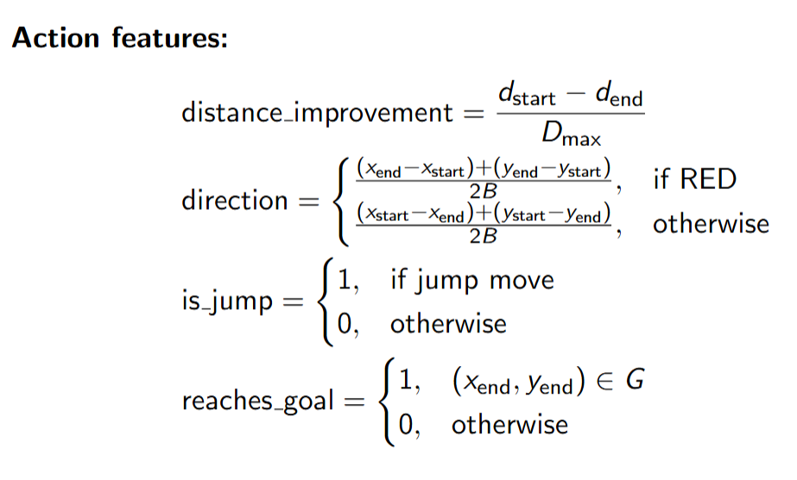
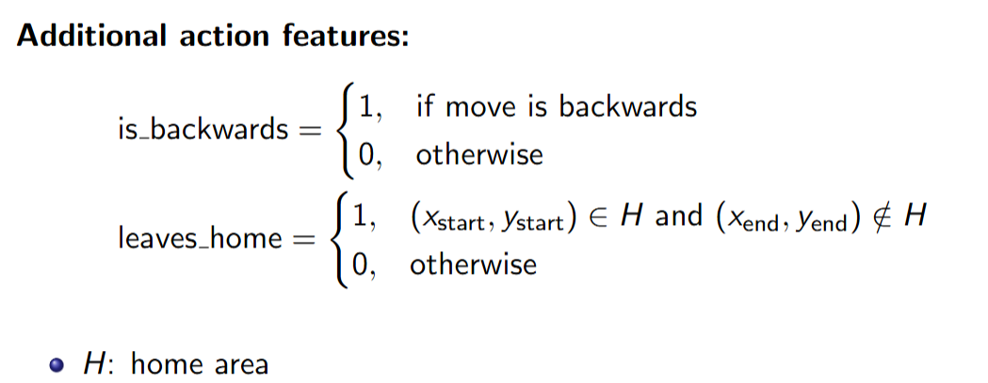

Slide 13
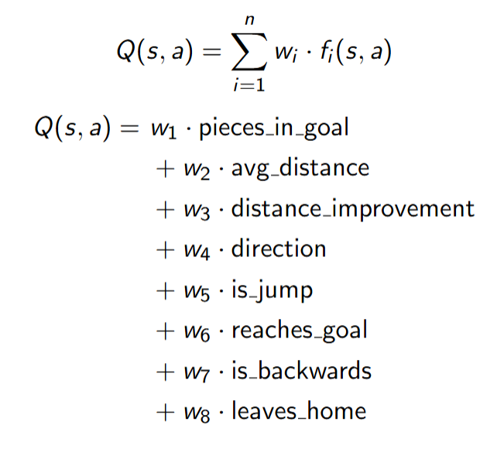

Slide 14
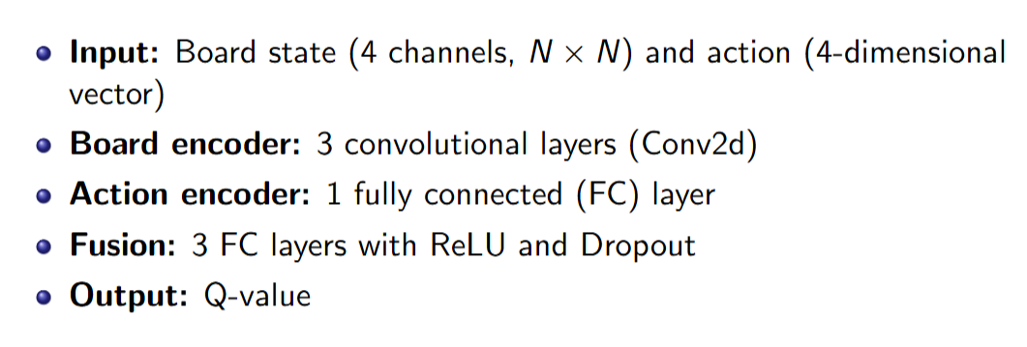
Neural Approximate Q-learning: Network Architecture

Slide 15
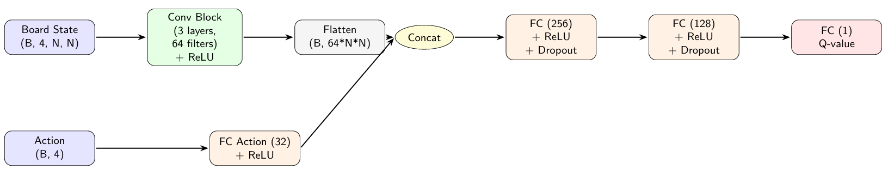
Diagram

Slide 16
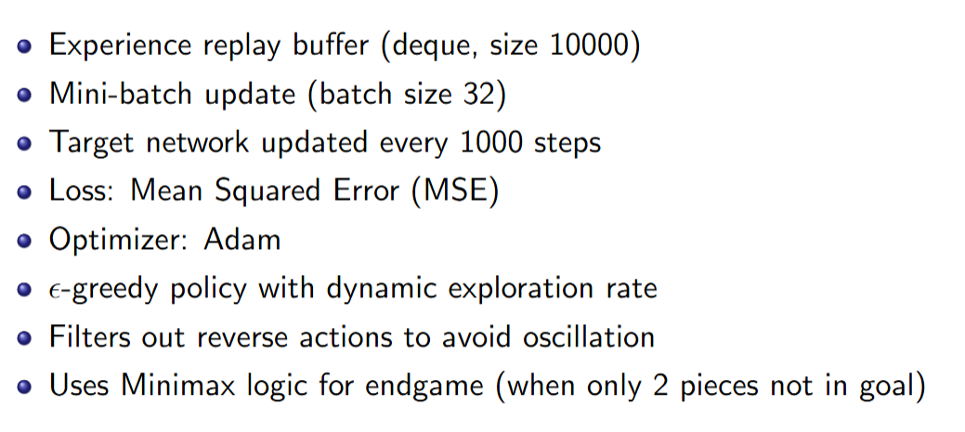
Training Detail

Slide 17
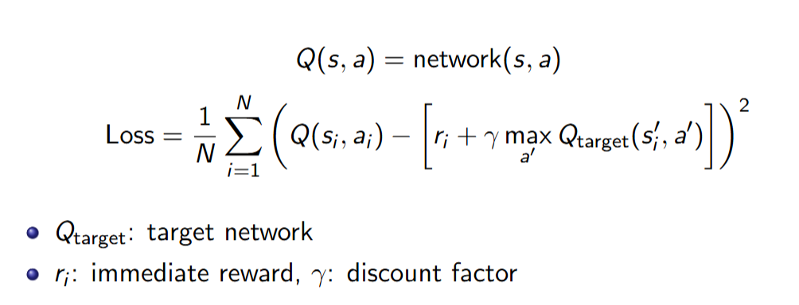

Slide 18
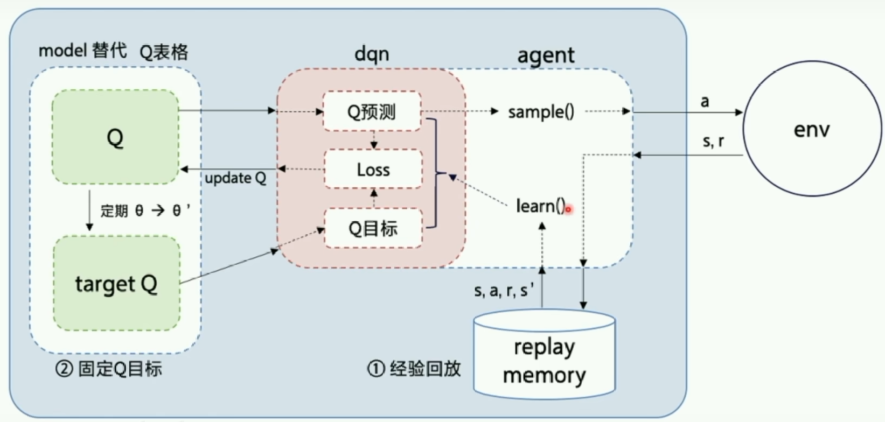
[1] https://www.bilibili.com/video/BV1yv411i7xd/
[2] DQN paper: https://arxiv.org/abs/1312.5602

Slide 19
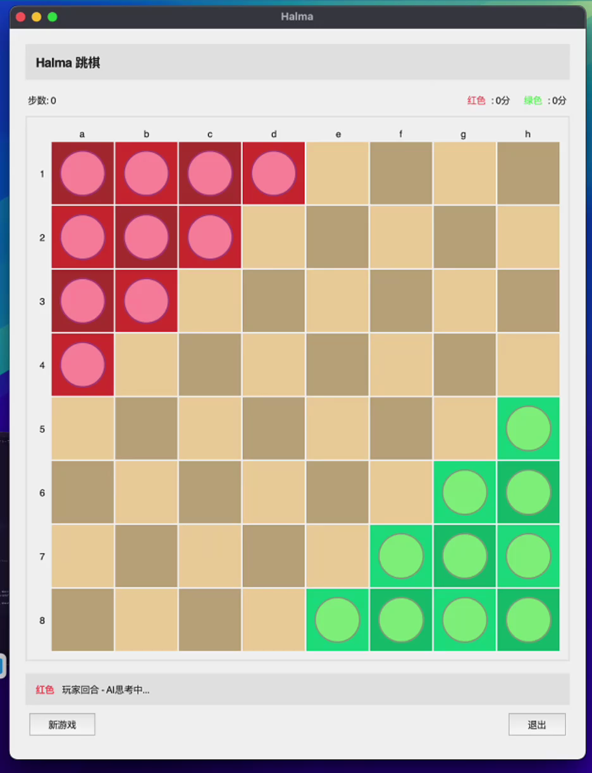
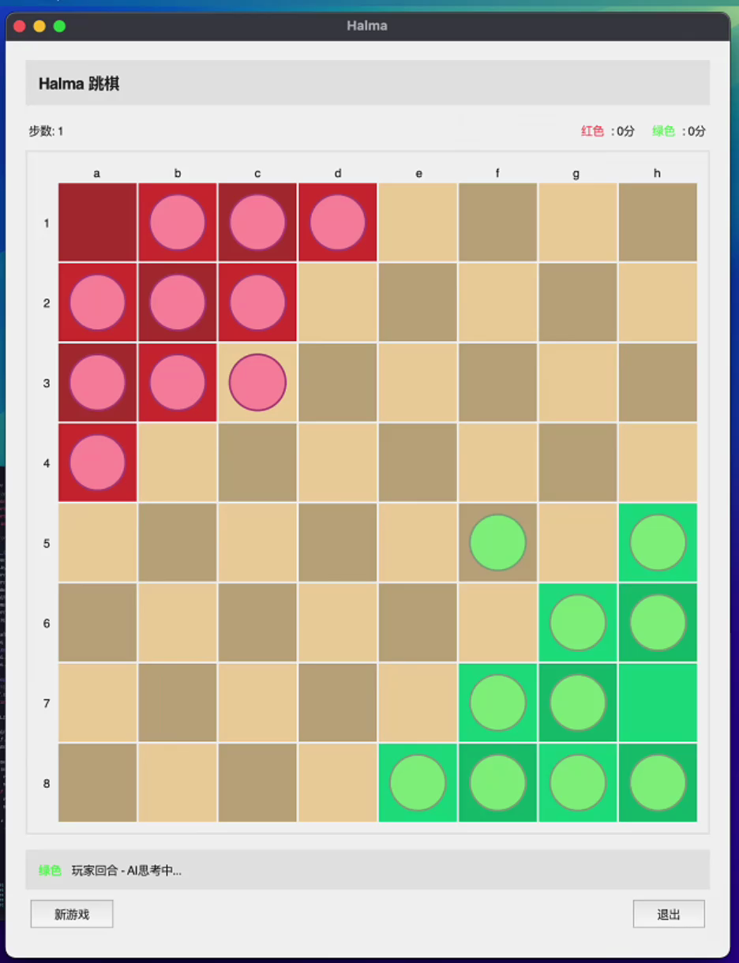
NAQL vs. Minimax
AQL vs. Greedy

Slide 20
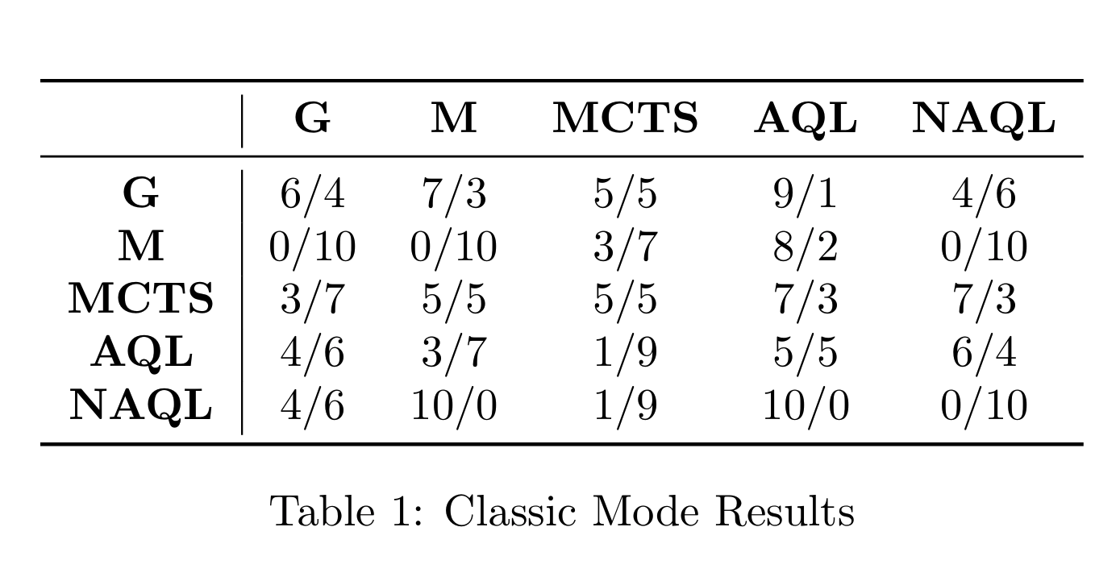
Results

Slide 21
Misc
Added Scoring Rules
Each pawn entering the goal area: +10 points
For a chain jump, score += number of consecutive jumps in the chain
All pawns in the goal area (first player): +100 points
By adjusting different jump reward, we find something interesting...

Slide 22
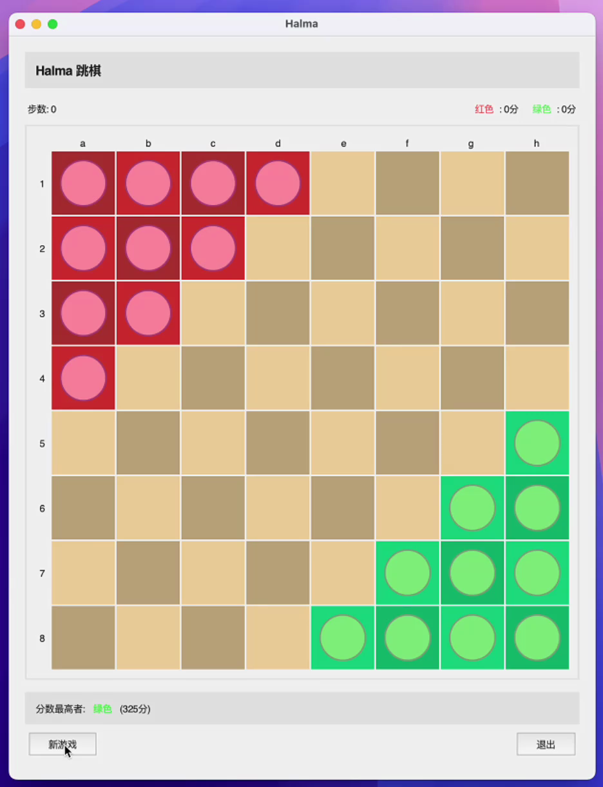
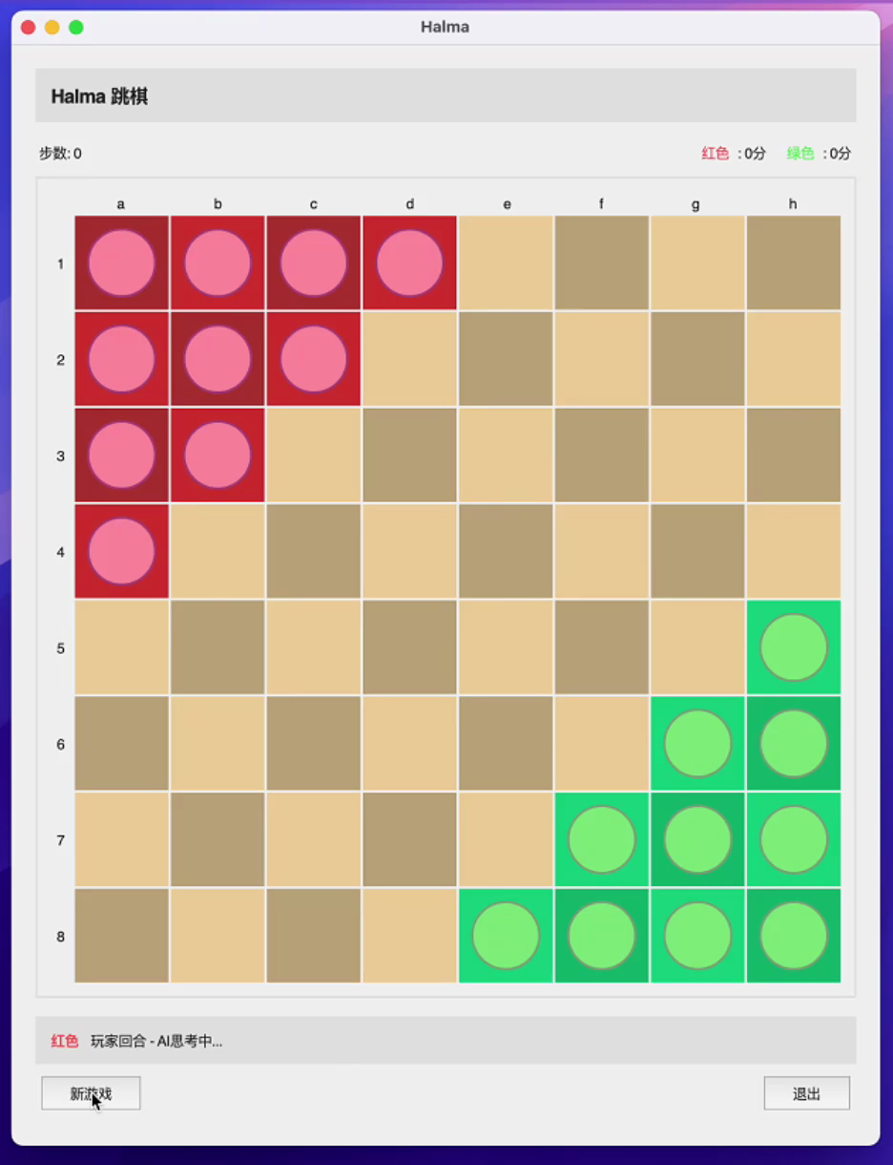
jump reward * 1
jump reward * 10

Slide 23
Thank You!
Contribution: 熊章智：All agents under ‘no rule changes’; Presentation
杨天倪：Rule Changer and Explorer; Code Project Engineer(UI, intercaces, etc); Presentation
冯令康：Minor contribution

